Slide 1
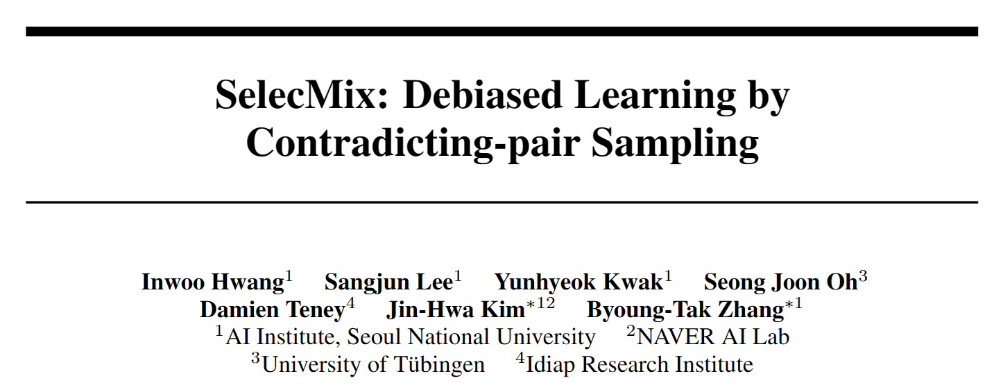
NeurIPS 2022
2023.12.20

Slide 2
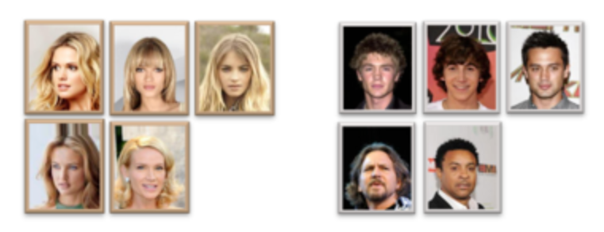
SelecMix: Debiased Learning by Contradicting-pair Sampling [NeurIPS 2022]
Background
A feature is biased if it displays a pattern that is statistically predictive of the labels over the dataset, though not necessarily on every example. For instance, a blue background may be present in most (but not all) images of birds. These images are said to be bias-aligned (displaying spurious correlations).

Slide 3
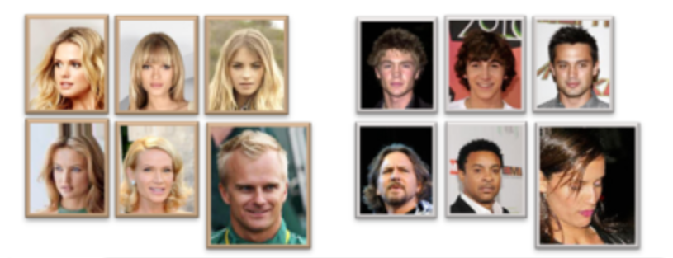
SelecMix: Debiased Learning by Contradicting-pair Sampling [NeurIPS 2022]
Related work
Debiasing with known forms of bias or bias labels.
Debiasing with the easy-to-learn heuristic.
A popular approach is to train an auxiliary model that intentionally relies primarily on the easy-to-learn biased features (We assume that biased features are easier to learn than robust ones, because they are involved in simpler (e.g., linear) predictive patterns). Bias-conflicting training examples are identified based on the relative losses from the biased and debiased models, then upweighted for the training the debiased model.

Slide 4
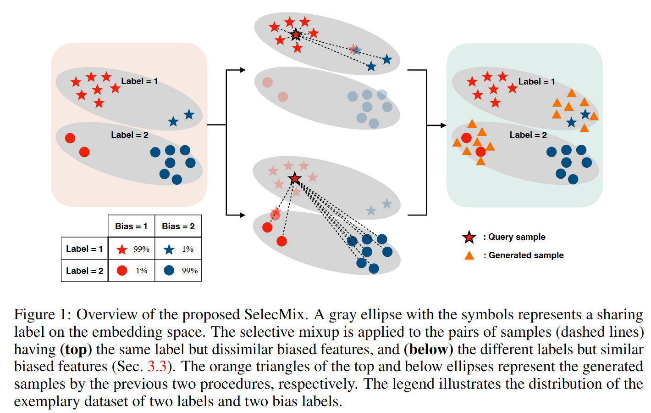
SelecMix: Debiased Learning by Contradicting-pair Sampling [NeurIPS 2022]
Motivation
We propose an alternative based on mixup, a popular augmentation that creates convex combinations of training examples. Our method, coined SelecMix, applies mixup to contradicting pairs of examples, defined as showing either (i) the same label but dissimilar biased features, or (ii) different labels but similar biased features.

Slide 5
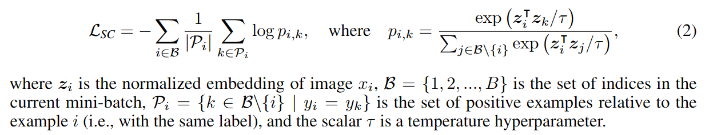
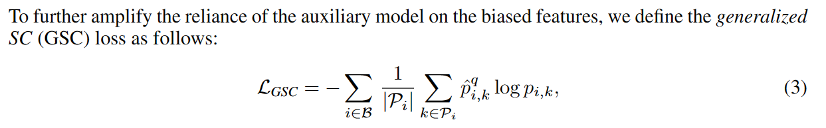
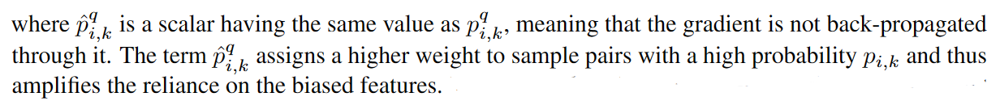
SelecMix: Debiased Learning by Contradicting-pair Sampling [NeurIPS 2022]
SC and GSC losses

Slide 6
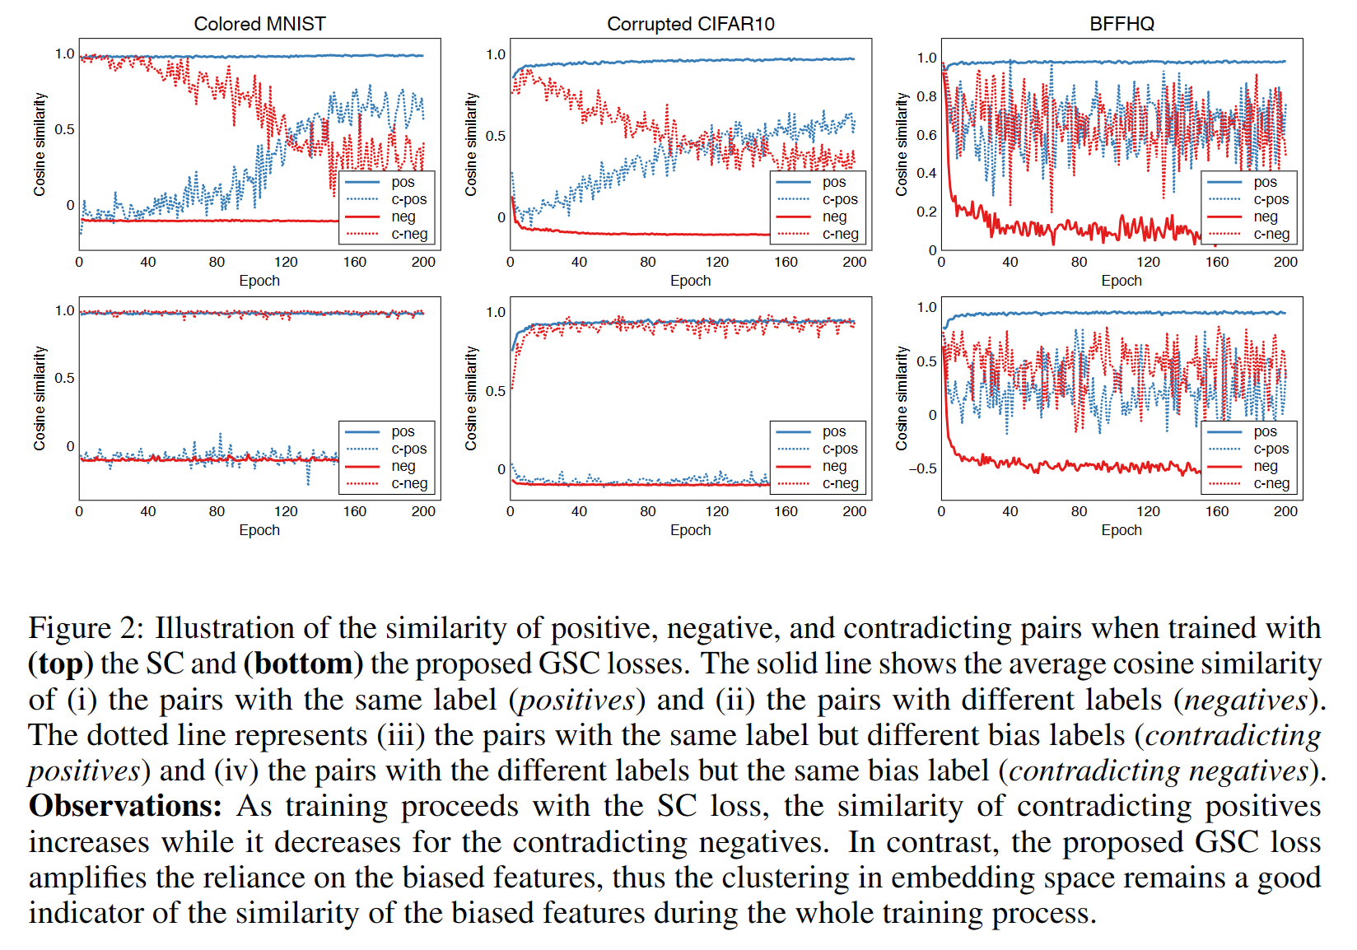
SelecMix: Debiased Learning by Contradicting-pair Sampling [NeurIPS 2022]
SC and GSC losses

Slide 7
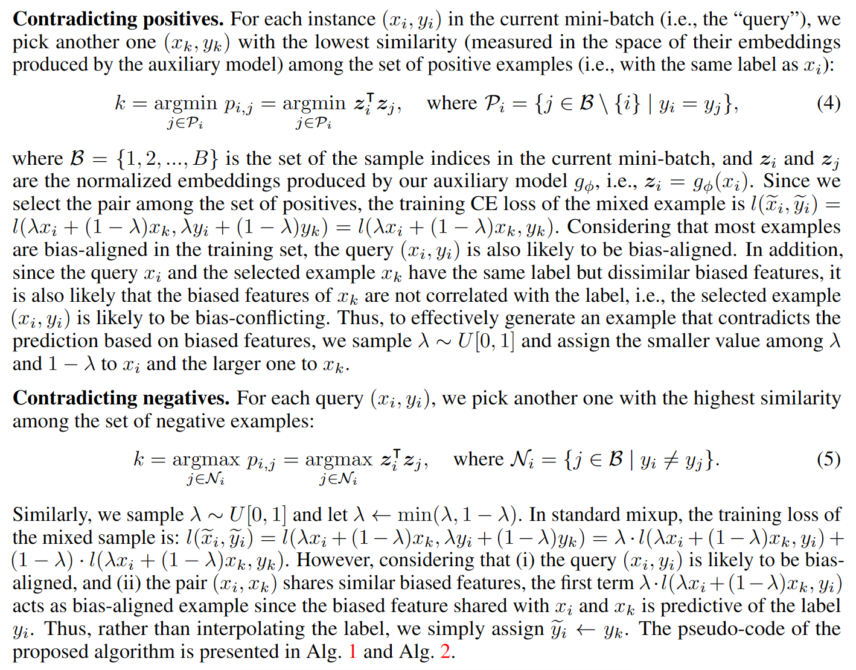
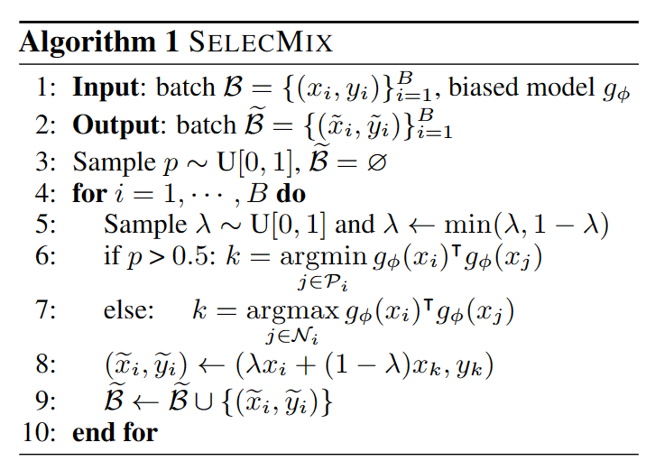
SelecMix: Debiased Learning by Contradicting-pair Sampling [NeurIPS 2022]

Slide 8
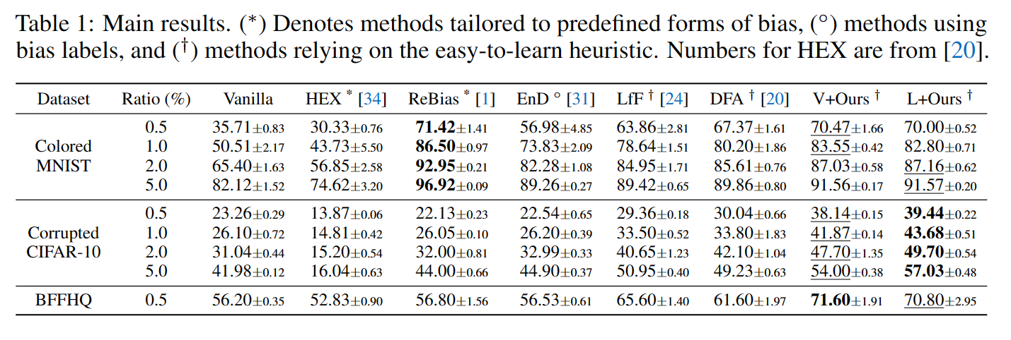
SelecMix: Debiased Learning by Contradicting-pair Sampling [NeurIPS 2022]

Slide 9
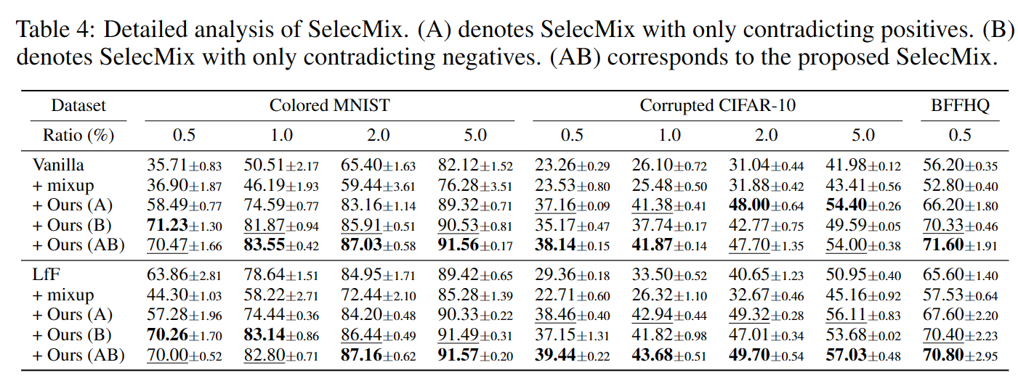
SelecMix: Debiased Learning by Contradicting-pair Sampling [NeurIPS 2022]

Slide 10
Thanks

